Slide 1
EmoJNS
Starknet DID + SocialFi
🐶💩.stark

Slide 2
Table of contents
01
02
03
04
05
Introduction EmoJNS
Roadmap
Team
Competitor
Contact

Slide 3
01
Introduction EmoJNS

Slide 4
Introduction
EmoJNS is a community-led, fun and joyful starknet DID + SocialFi project with strong meme attributes.
Users can choose their favorite EMOJI registered domain name, which can be used to display personal homepages (Twitter, LinkedIn, Telegram, etc.) for social networking.
They can also use our IM applications to chat, transfer tokens, etc. (under development).

Slide 5
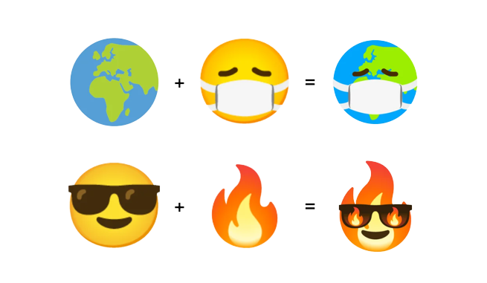
Our team will develop SDKs, users can independently develop EMOJI culture, and community members can participate in independent creation and spread EMOJI culture with low threshold.

Slide 6
Roadmap
02

Slide 7
Roadmap
Register domain names (Testnet, Mainnet) 2023.11
DID (business card) 2023.12
Instant Messaging 2024.01
EMOJI Culture 2024.03

Slide 8
Registered domain names
NFT
Your domain name is an NFT, and your number is TokenID.

Slide 9
DID
Personal Pages (business card)
You can generate your personal page, and link to social media (Twitter, LinkedIn, Telegram, etc.) and display your on-chain NFT.
SDKs
In the future, our team will package the query function into SDK. Other projects can obtain the user's social media information through the on-chain address.

Slide 10
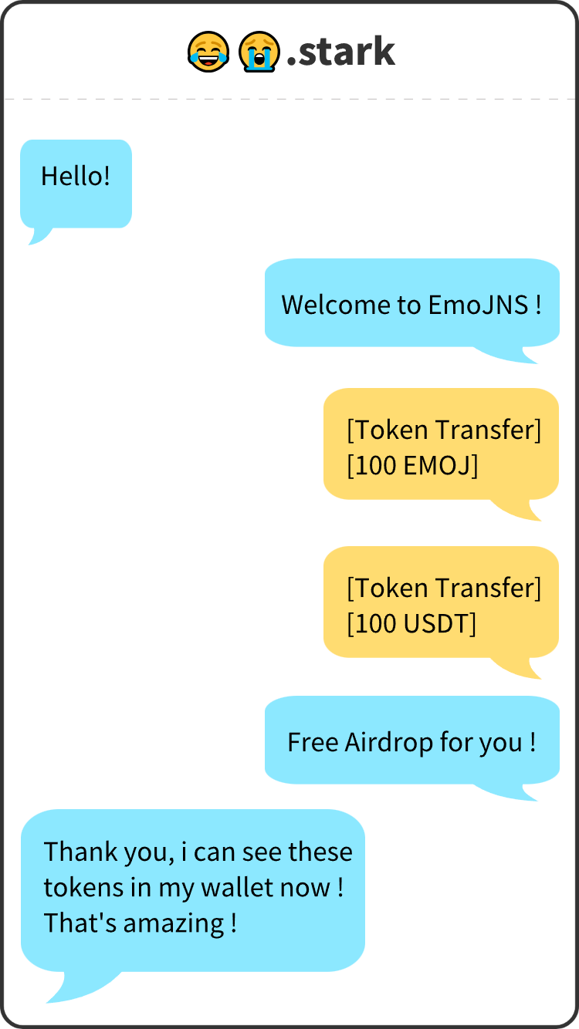
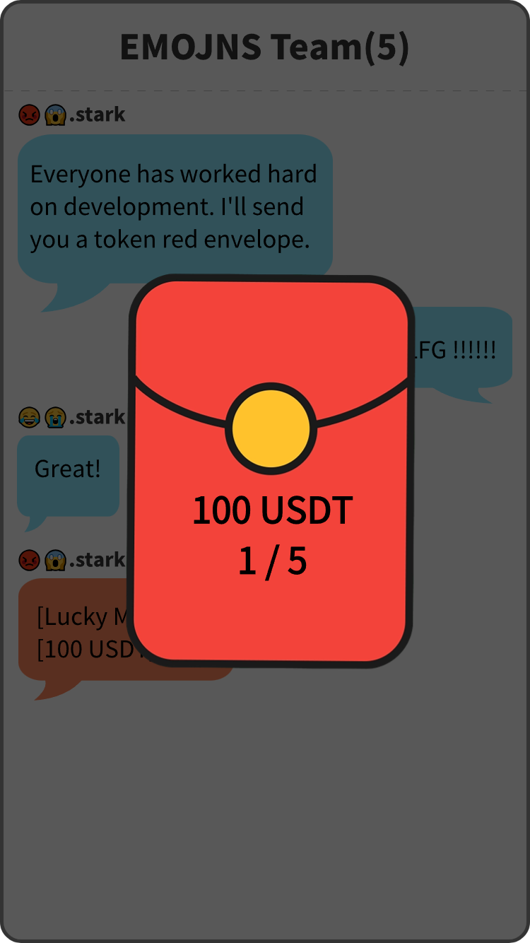
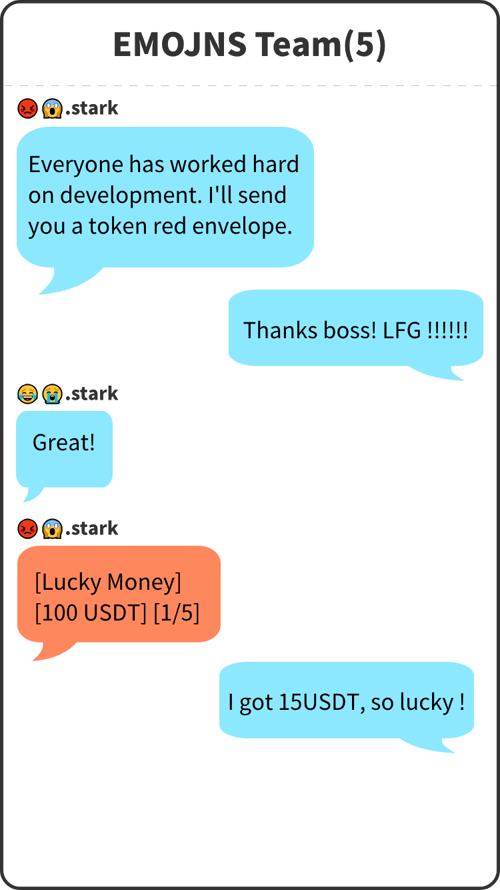
Instant Messaging
Social Platforms
Develop IM chat,
Group chat,
Token transfer,
and Lucky Money.

Slide 11


EMOJI Culture
Community Culture
Create and spread bset EMOJI, if it is used a lot (on-chain & off-chain),
it will be divided into tokens.
Customize EMOJI
👍.stark
Other project can customize their logo use EmoJNS.
🔄.stark

Slide 12
03
Team

Slide 13



Our team
Ethan Ye
Stanley Ma
Maxlion
Founder
Co-founder
Adviser
Full-stack developer, Chainlink/ETH Shanghai/
ETH Beijing/AWS Hackathon champion🥇
Full-time responsible for front-end and contract development in EmoJNS.
Ex-cryptoVC invsetment manager, responsible for primary market investment and financing.
Full-time responsible for BD and user growth in EmoJNS.
Current StarknetAstro
co-founder. Core contributor of starknet Chinese community.
Part-time responsible for PR in EmoJNS.

Slide 14
Competitor
04

Slide 15
Competitors
ENS
StarknetID
Y.at
ENS supports EMOJI domains, but it has few regeists. It can only mark addresses on the Etherscan. It has no practical use and no community support.
StarknetID is the largest domain name project on starknet. Its purpose is similar to ENS. StarknetID does not support EMOJI domains. Our product can fill this gap very well.
Yat is a successful web2 project. Its main function is to display personal pages through EMOJI domains, which can display opensea Twitter, etc., similar to linktree.
EmoJNS Advantage
Backed by community.
Not just a domain names, but a social tool.
All operations on-chain.

Slide 16
05
Contact

Slide 17
Thanks!
https://emojns.vercel.app (Demo version)
Twitter: @StarkEmoJNS

